Slide 1
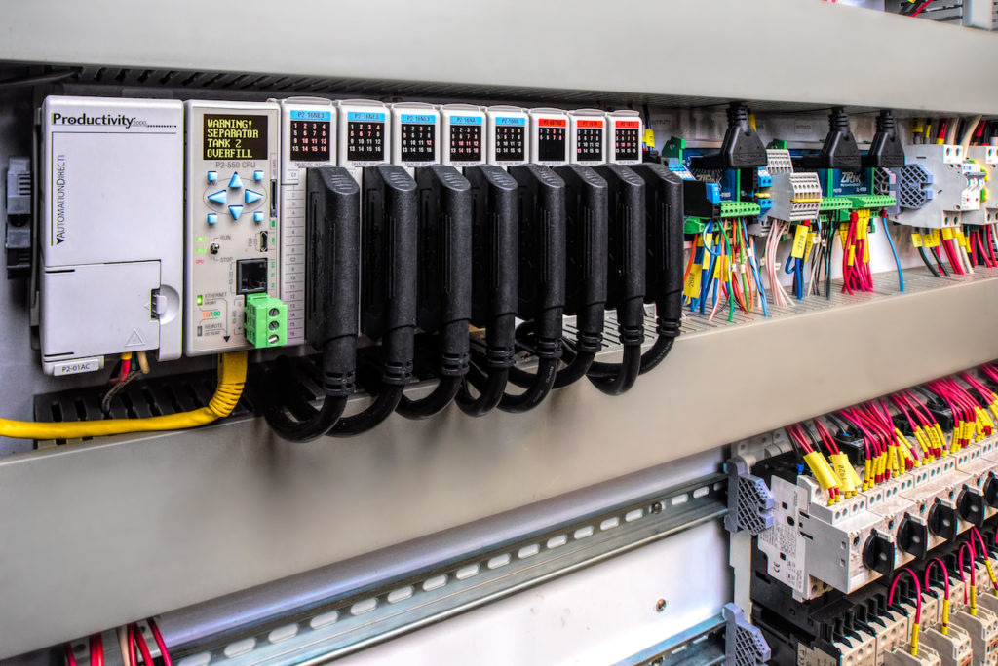
INDUSTRIAL SECURITY
CIS 2640: Network security
Craig

Slide 2
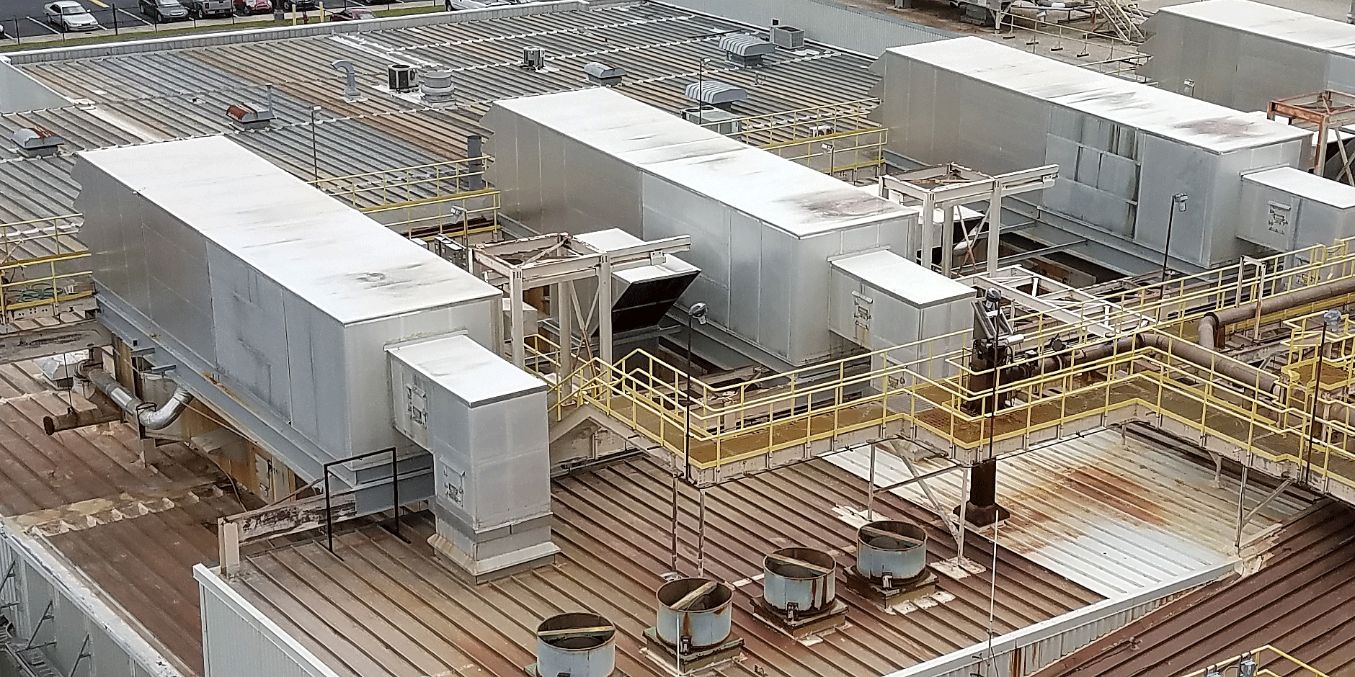



Importance of ics security
Industrial control systems (ICS) are used to control utilities and factory automation
Control real-life equipment.
Failure could result in property damage, injury, death

Slide 3
Two different mindsets
OPERATIONAL TECHNOLOGY
INFORMATION TECHNOLOGY
Machine to machine communication
Low Bandwidth, Real-time
Risks: Human Safety, Property Safety
Priority: Control, Availability
Predictable Device Behavior
User-centric communication
High Bandwidth, Delay-Tolerant
Risks: Data Security, Data Integrity
Priority: Integrity, Confidentiality
Unpredictable Device Behavior
Notes:
-OT, machines run same process constantly, only have to run several times to get traffic baseline
-IT traffic is erratic, might be large downloads occur at different times
-OT protocols do not have security, have to be fast, light-weight, don’t care as much about confidentiality

Slide 4
Real World/physical impact
Inputs
Controlled Process
Outputs
Typically raw process material
Combined use of sensor, actuators, controllers, HMI
Converts raw material to finished product
PID Loop, Fuzzy Logic, PWM
Finished material/process
Usually controller outputs
Physical device that controls process
Valves, motors, pumps
Actuator
Sensors
Provide analog “real-life” measurements to controller
Flow, Pressure, Temp
Controller
Screen to view process measurements
Can be used change settings in controller
Program controls Inputs/Outputs
Responsible for controlling process
Human-Machine Interface
Notes:
Main point of failure, controller: compromise view, monitor, control functions
Stuxnet Centrifugal Drive System failure by manipulating VFD speeds
Typical cell environment, not SCADA DCS environment (those are larger systems)

Slide 5



ICS control methods
VIEW
MONITOR
CONTROL
Operator views readings on HMI
Determination of deviation is operator controlled
Attackers can manipulate values shown on HMI
Controller collects sensor measurements
Controller is responsible for determination of deviation
Attacker can manipulate values seen by controller
Control mechanisms (PID Loops, PWM, Fuzzy Logic)
Controls outputs (pumps, valves, motors)
Attacker can manipulate control mechanism

Slide 6
Defending ICS Systems
Policies/Procedures
Physical
Network
Computer
High-level guidelines and instructions on ICS security
Control personnel allowed in restricted areas
Restrict access to logical areas, logging events
Patching strategies, preventing access to unused ports
Application
Prevent unauthorized access interactions with programs/services
Device
Controller hardening, designing resiliency/redundancy
Notes:
Defense-in-Depth provides guidelines on how to protect all aspects of an ICS environment

Slide 7
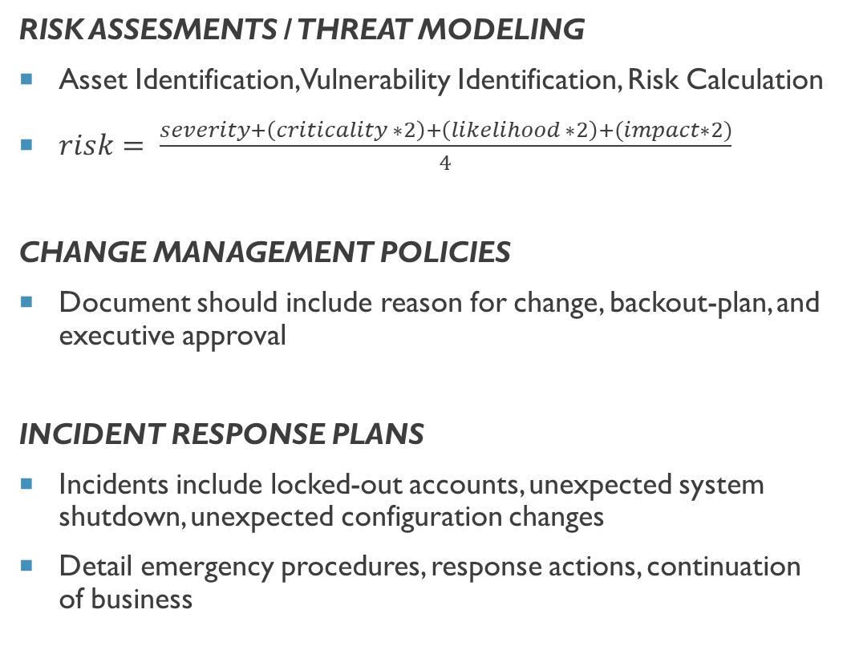
POLICIES / PROCEDURES
RISK ASSESMENTS / THREAT MODELING
Asset Identification, Vulnerability Identification, Risk Calculation
$risk= \frac{severity+\left(criticality ∗2\right)+\left(likelihood ∗2\right)+(impact∗2)}{4}$
CHANGE MANAGEMENT POLICIES
Document should include reason for change, backout-plan, and executive approval
INCIDENT RESPONSE PLANS
Incidents include locked-out accounts, unexpected system shutdown, unexpected configuration changes
Detail emergency procedures, response actions, continuation of business
Post Incident
Analysis/Forensics
Planning
Incident Prevention
Recovery
Remediation
Containment
Detection
Notes:
-Policies / Procedures help define security posture of company
-Policies should be made about information collecting from ICS systems, since they could fail with IT protocols
NIST guidelines here: https://nvlpubs.nist.gov/nistpubs/SpecialPublications/NIST.SP.800-82r2.pdf
Risk assessments should define likelihood, impact, and criticality. Matrices should be developed to help quantify these. Criteria for matrices should be developed by organization

Slide 8
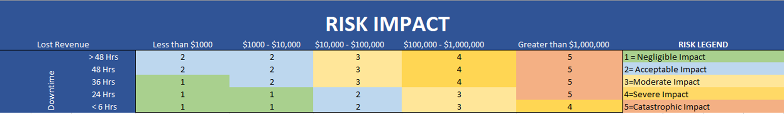
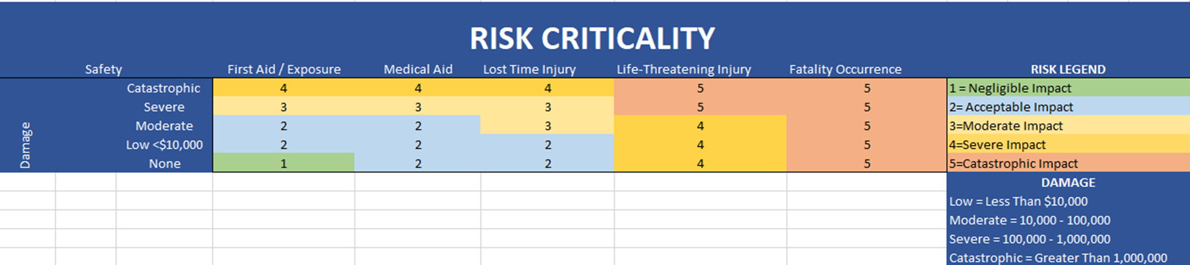
RISK Evaluation

Slide 9
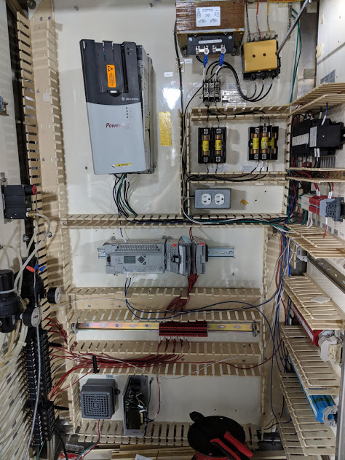
PHYSICAL Security
LOCK AND KEY
Control cabinets should have lock, key stored in safe location
Interlock for process STOP when cabinet door is open
AUTHORIZED PERSONNEL
Only allow qualified/authorized employees to work on control systems
Outside contractors should always be accompanied by company employee
EQUIPMENT PLACEMENT
Placing equipment on ICS or enterprise network
Notes:
-Drop Ceilings
-Biometrics / smart cards into manufacturing zones, building facilities

Slide 10
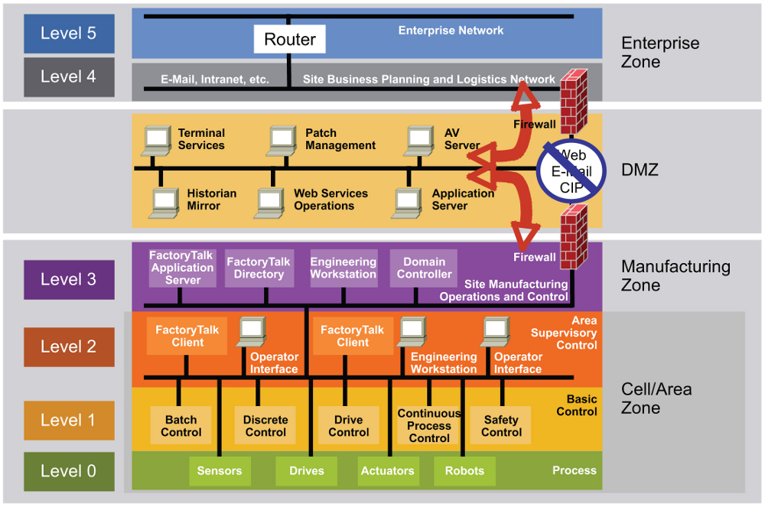
NETWORK Security: ISA – 99 FRamework
ENTERPRISE NETWORK
Scheduling
Supply Chain Management
More IT focused
DEMILITARIZED ZONE
Prevents direct communication between IT and OT
Provides extra layer of security
ICS NETWORK
Process Control
Process Control Historian/Logging
Notes:
Adapted from Purdue Reference model
ISA = Industrial Society of Automation
ISA-99 Framework describes basic functions and composition of a manufacturing system
NIST defines guidelines on segmenting network into ICS and enterprise systems
Firewalls control traffic entering/exiting ICS network. Stops compromised servers from entering ICS, prevents industry protocols entering enterprise network

Slide 11
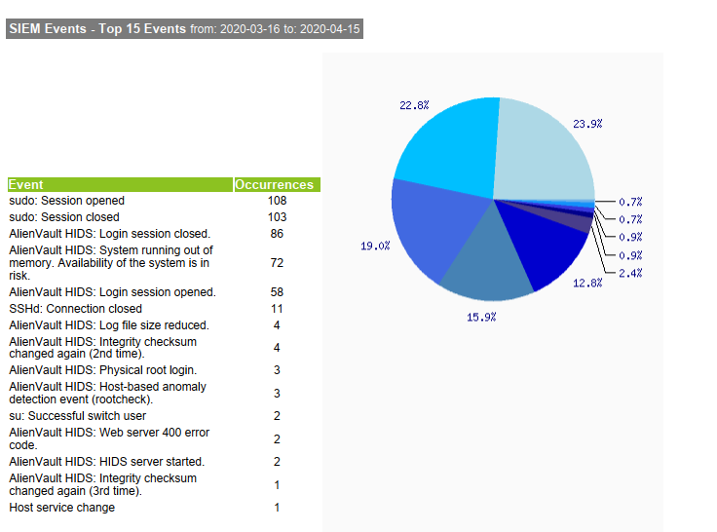
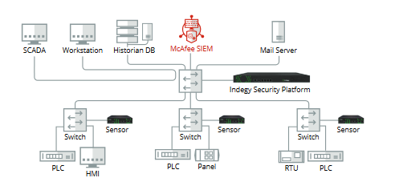
Network Security
NETWORK SEGMENTATION
Limits broadcast/collision domains
Reduces attack surfaces
LOGGING
Firewall, router, switch, OS, application logs
Network Packet captures
SIEM uses algorithms and other logic to display network activity
NETWORK RESTRICTIONS
False-positives from security appliances can block critical ICS traffic
Notes:
-Firewall can be configured to forward ICS traffic to scanners for asset identification, vulnerability assessments, etc.
SIEM = Security Information and Event Management

Slide 12
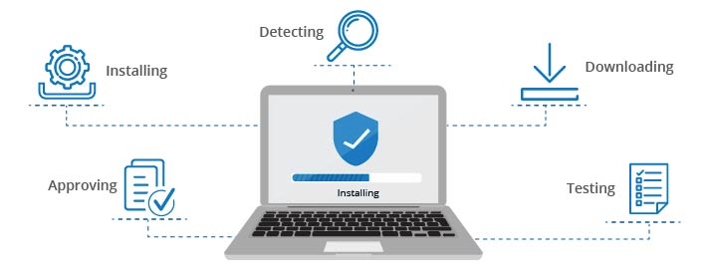
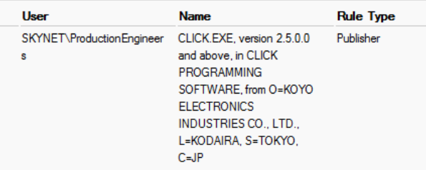
Computer security
APPLICATION LISTING
Use application control software to whitelist allowed applications
Microsoft AppLocker, Symantec Critical System Protection
USER RESTRICTED ACCOUNTS
Create dedicated service accounts to run various services
Attackers cannot use compromised accounts to control services
PATCH MANAGEMENT
Updates must pass through IDMZ to be applied on ICS devices
If possible, updates should be tested before deploying to ICS environment

Slide 13
APPLICATION SECURITY
INPUT VALIDATION
Filter all input through appropriate conditions
Set boundary limits for process controls
AUTHORIZATION VULNERABILITIES
Use granular user privileges, least privilege practice
Enforce log-out on sessions after inactivity
ICS SECURE SDLC
Manage and maintain application from design phase to decommission
Phases: Planning, design, test planning, coding, testing and results, release and maintenance
Planning & Requirements
Architecture & Design
Test Planning
Coding
Testing & Results
Release & Maintenance
Notes:
SDLC = Software Development Life Cycle, planning, designing, and maintaining application until retirement

Slide 14
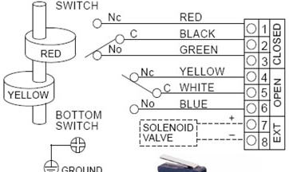
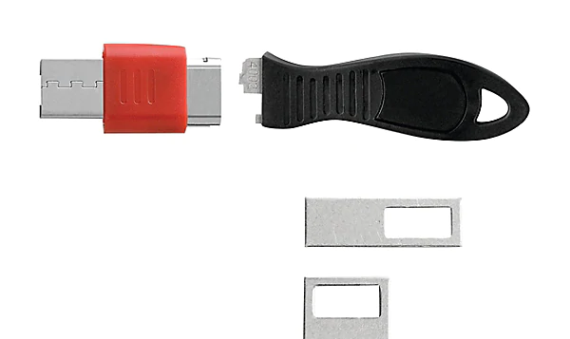
DEVICE SECURITY / HARdening
PORT BLOCKERS
Restrict access to controller ports using physical port blockers/disabling port in software
REDUNDANCY / RESILIANCY
Multiple safety interlocks should be used, hardwired switches for emergencies
Hard-wired Master Control Relays to control entire process
DISABLE UNUSED COMMUNICATIONS
Disable unused remote management protocols
Disable OT protocols where not used
Notes:
System should be designed for device failure. When device fails, failure indication should signal fault condition. Ex. When using lights for critical faults, light should be lit for normal operation. If light burns out, still shows fault condition

Slide 15

INDUSTRY PROTOCOLS
Main ICS Concern = AVAILABILITY
Light Weight: provide stability, performance
Weak/No Security
Protocols are now starting to support common media type: Ethernet
Protocols can now run on top of IP
Robert M. Lee & Jeff Haas: Little Bobby

Slide 16
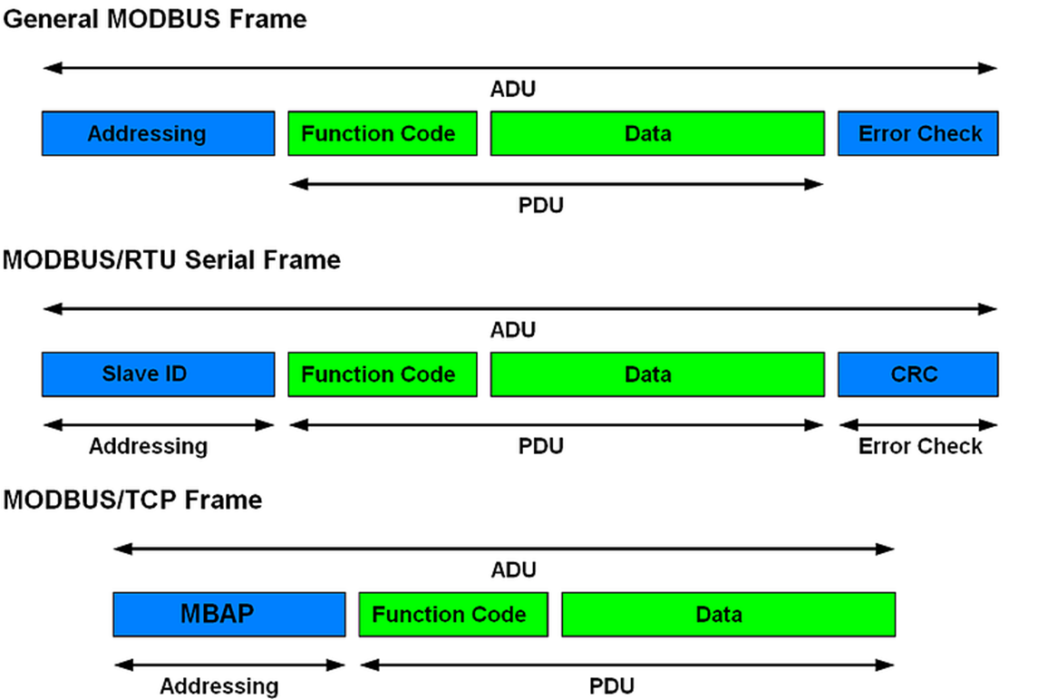
Modbus protocol
MODBUS developed in 1979
MODBUS has both serial and ethernet capabilities
MODBUS differentiates between serial/ethernet media through Application Data Unit (ADU)
ADU for serial includes address header and error checksum
ADU for ethernet includes MBAP
Notes:
MODBUS RTU = Master/Slave devices
MBAP = MODBUS Application
MAP contains: transaction ID (2 bytes to identify each request, almost like SYN packets)
Protocol ID: (2 bytes set by the client, always 00 00)
Length: (length and 2 bytes identifying number of bytes in data portion of ADU)
Unit ID: (unit ID and 1 bytes set by client echoed by the server for identification of a remote slave)

Slide 17
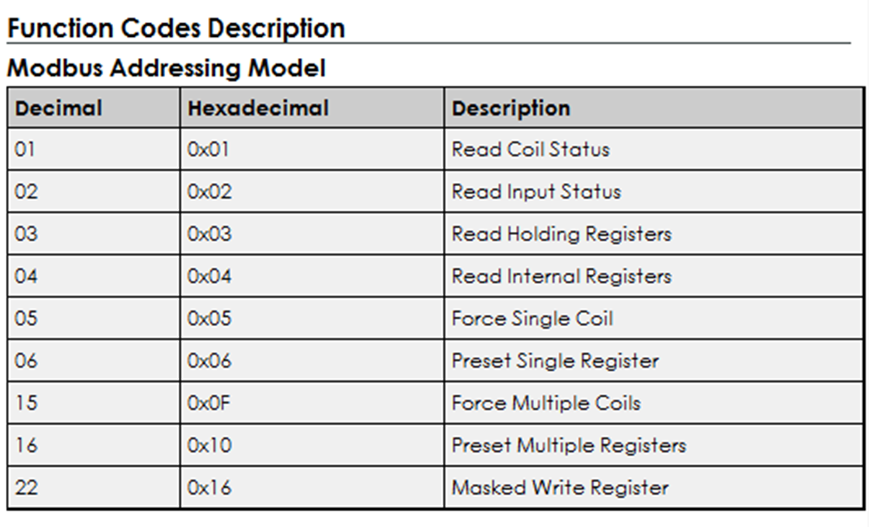
Modbus protocol
MODBUS uses function codes to read/write data to devices
Function code specifies service requested (read coil, read register)
Registers are 16 bit addresses that can hold INT values
Coils are 1-bit Boolean addresses that hold BOOL

Slide 18
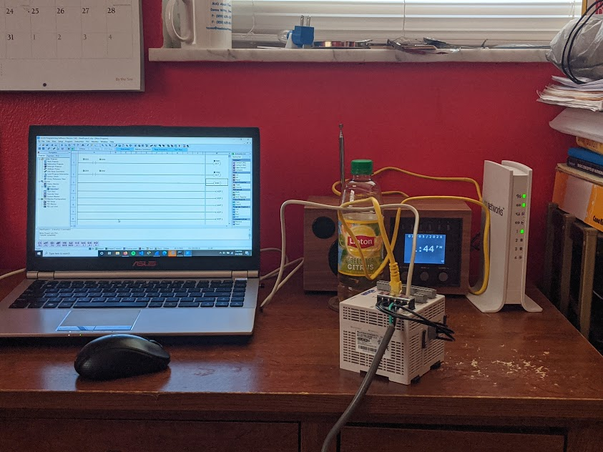
HACKING MODBUS
1
3
4
Windows / Kali Linux Machine
(192.168.1.24 Windows)
(192.168.1.33 Kali VM)
2. CLICK PLC: C0-12DD2E-D
(192.168.1.39)
3. ON Networks Router
(Gateway 192.168.1.1)
4. Lipton Green Tea Citrus
2

Slide 19
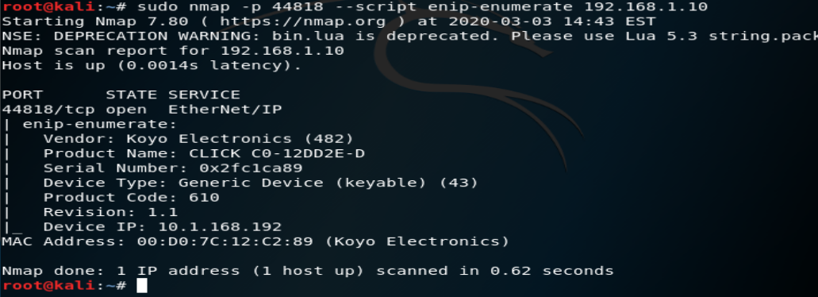
HACKING MODBUS: STEPS
Used Redpoint library to find more information about PLC
Find more information about PLC (Vendor, Product Name, CPU Type)
GitHub repo: https://github.com/digitalbond/Redpoint

Slide 20

HACKING MODBUS: STEPS
Installed MODBUS client on Kali Linux VM
Used MODBUS client to read DATA (16 bits) registers from CLICK PLC
%MW0 specifies which DATA register to read from
2 specifies number of data registers to read, counting beginning register
First DATA register holds value of 1
Second DATA register holds value of 2

Slide 21
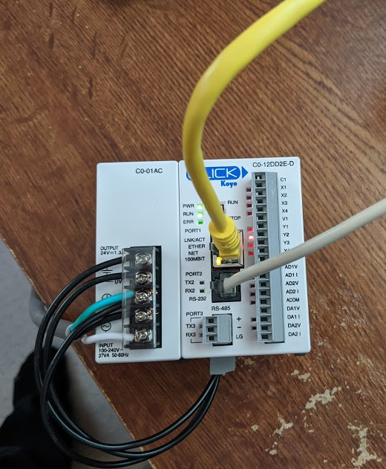
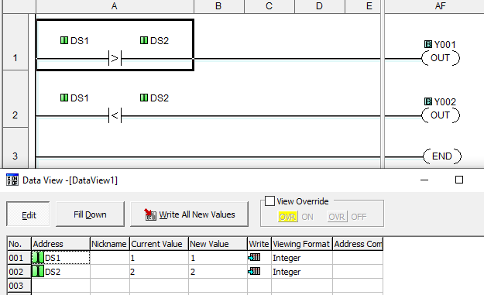
Hacking modbus: Steps
DS1 holds

Slide 22
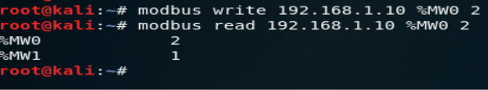
HACKING MODBUS: STEPS
Used MODBUS client to write to DATA (16 bits) registers in CLICK PLC
First DATA register now holds value of 2
Second DATA register now holds value of 1

Slide 23
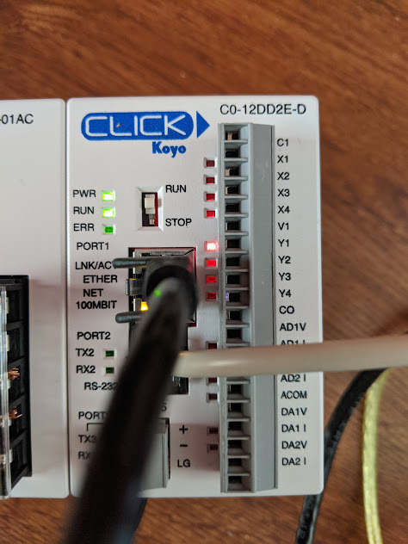
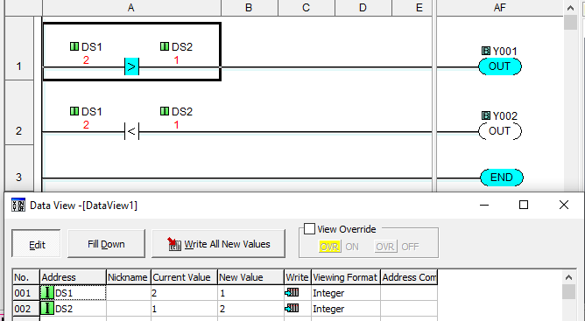
HACKING MODBUS: STEPS

Slide 24


CONCLUSION
Defending an ICS environment can be a “catch-22”
Defending an ICS environment can be difficult due hardware, network, and physical limitations and restrictions
Industrial protocols have weak or no security, protocols designed to be stable and fast
Compromises in an ICS environment can be noticed quicker than IT because of abnormal machine operation

Slide 25
references
Ackerman, P. (2017). Industrial Cybersecurity. Birmingham, UK: Packt.
Cisco. (n.d.). Networking and Security in Industrial Automation Environments Design and Implementation Guide. Retrieved from Cisco.com: https://www.cisco.com/c/en/us/td/docs/solutions/Verticals/Industrial_Automation/IA_Horizontal/DG/Industrial-AutomationDG/Industrial-AutomationDG.html
Department of Homeland Security. (n.d.). Recommended Practice for Patch Management of Control Systems. Retrieved from us-cert.gov: https://www.us-cert.gov/sites/default/files/recommended_practices/RP_Patch_Management_S508C.pdf
Digital Bond. (n.d.). Digital Bond Redpoint Repo. Retrieved from Github: https://github.com/digitalbond/Redpoint
Evergreen Systems Inc. (n.d.). Sample IT Change ManagementPolicies and Procedures Guide. Retrieved from SANS Institute: https://www.sans.org/cyber-security-summit/archives/file/summit-archive-1493830822.pdf
Micheal J. Assante, R. M. (n.d.). The Industrial Control System Cyber Kill Chain. Retrieved from SANS Institue: https://www.sans.org/reading-room/whitepapers/ICS/industrial-control-system-cyber-kill-chain-36297
National Institute of Standards and Technology. (2015). NIST Special Publication 800-82 Revision 2. National Institute of Standards and Technology. Retrieved from https://nvlpubs.nist.gov/nistpubs/SpecialPublications/NIST.SP.800-82r2.pdf

